Slide 1
GEOGRAPHICAL THOUGHT 741
Geography is complex, inter-disciplanary;
Ancient (historical), modern and post-modernism perceptions of geography;
Why is theory important?
All geographical inquiry, is always shape by theory and philosophy;
How does theory shape geographical inquiry? – when you undertaking research: Title, theoretical base, method, findings (conclusion)

Slide 2
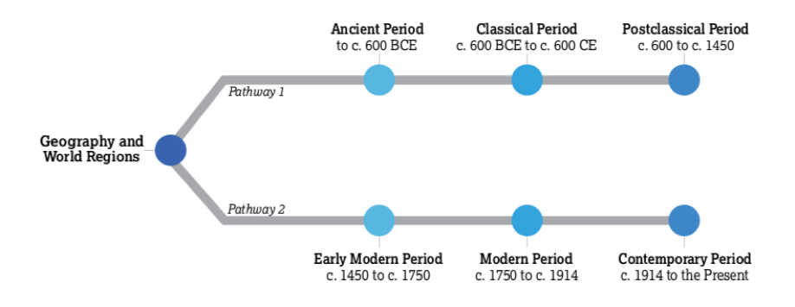
Evolution of Geography

Slide 3
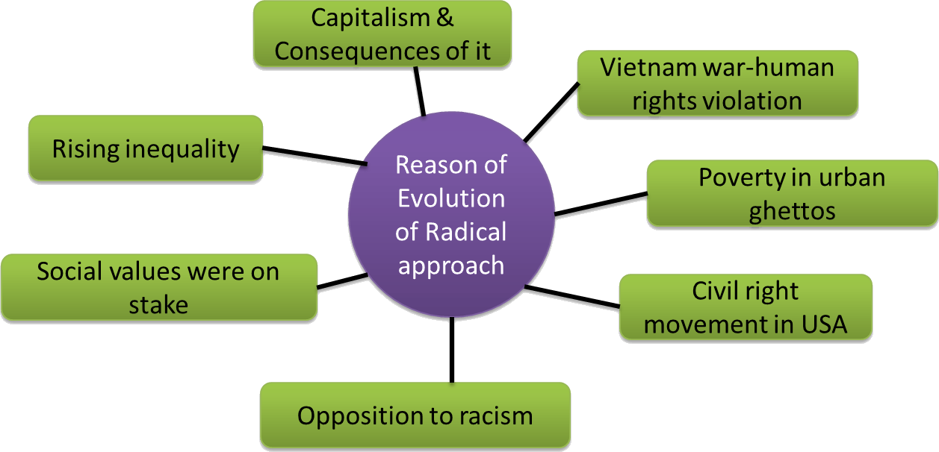
A look at the radical geography - 1960

Slide 4
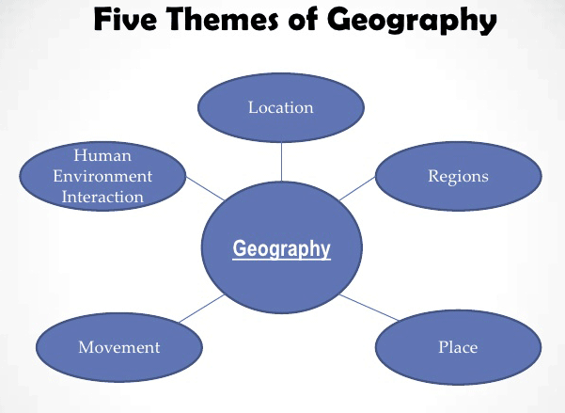
Themes of Geography

Slide 5
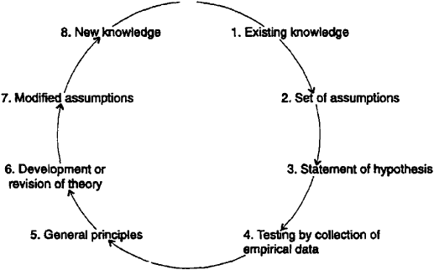
Good geography teacher – place-orientated perception (e.g.)

Slide 6
Importance of a theoretical base.
Theory shapes geographical study
Is it in the choices we make about what to include and what to ignore in our study
In conversation's, arguments your normally refer to a theoretical base
When e.g. you explore domestic space – you have to deal with about the evolution of space through time.
“Space is the boundless, three-dimensional extent in which objects and events occur. and have relative position and direction. It is no more than the collection of spatial relations. between objects in the world. Space is that which results from places taken together.”
Theory shapes geographical study is in the choices we make about to gather information.
What theory and or method to you follow?
Why?
How do you present you research to others?
What is the most appropriate Journal to submit your article – again you have to relate your theoretical base with the Journal’s theory core (field of study).

Slide 7
Theory is involved in all stages of geographical research
We may not clear about exactly how, but it is there nonetheless
Do you agree or disagree?
“Without theory, life (not just geography) would be chaos?”
What is theory?
The word theory does appear in everyday speech
Examples: You have a theory about a certain thing, but is it practical?
Theory can be impractical or unreal
Theory, in the academic sense, usually refers to organised and patterned sets of ideas than spur-of-the moments thoughts
Theories have a common, collective and enduring intellectual quality and concepts internationally
We understand and makes sense of world through theory (knowledge and experiences of previous theories)

Slide 8
The beginning of theory formation
Making the complexity of the world clearer
Ordering it and prioritising it
Observe and develop a mental approach to the practical world
Organise and put structure into your observations
Theory-building – the perceived and experienced world
People see things through difference lenses…. – we call it empiricism. We shared different perspective – we differ purely on the base of our theoretical base…
Therefore, there will also be different kinds of theory, different understandings of theory and even different theories of theory e.g. Marxism – NeoMarxism
Theories in science is more exact and more specific refer to social theory
Theories need a context and or base in which they depend on.
In our daily lives people come up with a theory, possible solutions to a theory….

Slide 9
Marxism
Is a theoretical approach in geography and across social sciences and humanities
Marxism consists of a lot of theories: economic theory, historical materialism, economic theory (e.g. exploitation of labour, overexploitation of mineral resources, etc.)
A theory of people’s relationships to commodities and a number of other theories especially in the human domain
Important - it cannot be tested (validate) as in natural science. WHY…
[please explain….?]

Slide 10
https://www.youtube.com/watch?v=fSQgCy_iIcc
Spatial science – is premised on a philosophy of positivism (when people are not determined by environmental conditions, like environmental determinism)
Central place theory and spatial interaction theory – these theories explain specific patterns, processes, etc.
Twentieth century – emergence of social theory
Theory about society
Later – becomes interdisciplinary
Main tenets – how society is structured and transformed
Transformation and transformation of social distinctions such as class and gender
1970’s –
Labour theory of value (value added), spatial interaction,
GEOGRAPHY BECOME COMPLEX AND INTEGRATIVE

Slide 11
“Theory is often overtly political. Certainly the traditions of critical social theory sought not simply to understand the world but, as Marx suggested, to change it.” Do you agree or disagree?
Critical theory
“is often used to refer to sets of ideas that are designed to provide a critique of the way things are and promote something better – the way could be.”
Question
1. What is your take on the following: What is theory, what is the main purpose of theory?
2. What is the purpose of doing research?
https://www.youtube.com/watch?v=qidnwbOhTus
https://www.youtube.com/watch?v=JCxEkaEuNQc
What is evident from a good theory? Can there be ‘good’ or ‘bad’ theories?

Slide 12
How do you understand the theory of Geography?
Have to understand the important elements of the history of the discipline
Subfields
They are not the same thing, but they are interrelated [please explain it to class]
Geography is more about theories and ideas
It is about relationships, e.g. geography and the state, geography versus private institutions, geography versus the community, geography versus the environment, etc.
Geography is about progress, development of new theories, new ‘ideas’, concepts…
The history of geographical ideas is as long as the history of any realm of ideas, but
Geography as a special field of study emerged during the establishment of universities

